Slide 1
Solution Architect Visits Solution Factory
Packaging First Solution

Slide 2
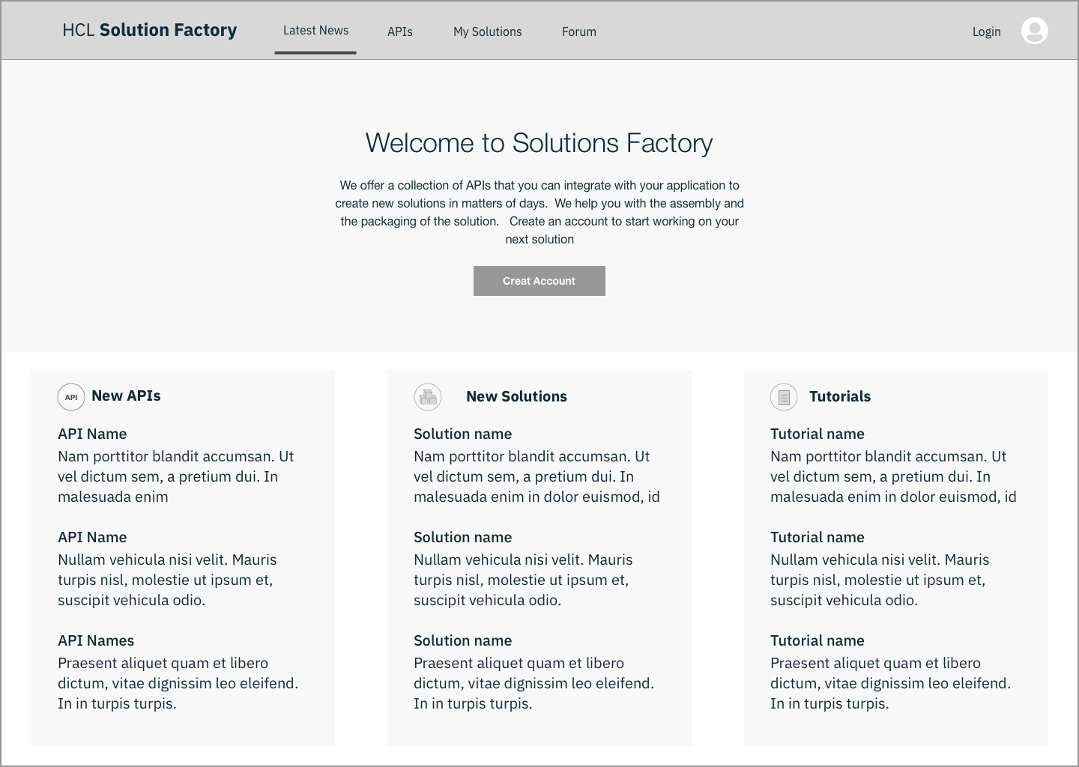
Solution Architect at the main page of SF.
Notes:
Learn that there are more than #### number of APIs available
Learn that X number of solutions have already been created with SF
Learn SF removes the pain of discovering APIs and composing solution.
See some quotes from other SF users
Call to action to signup. It's free.

Slide 3
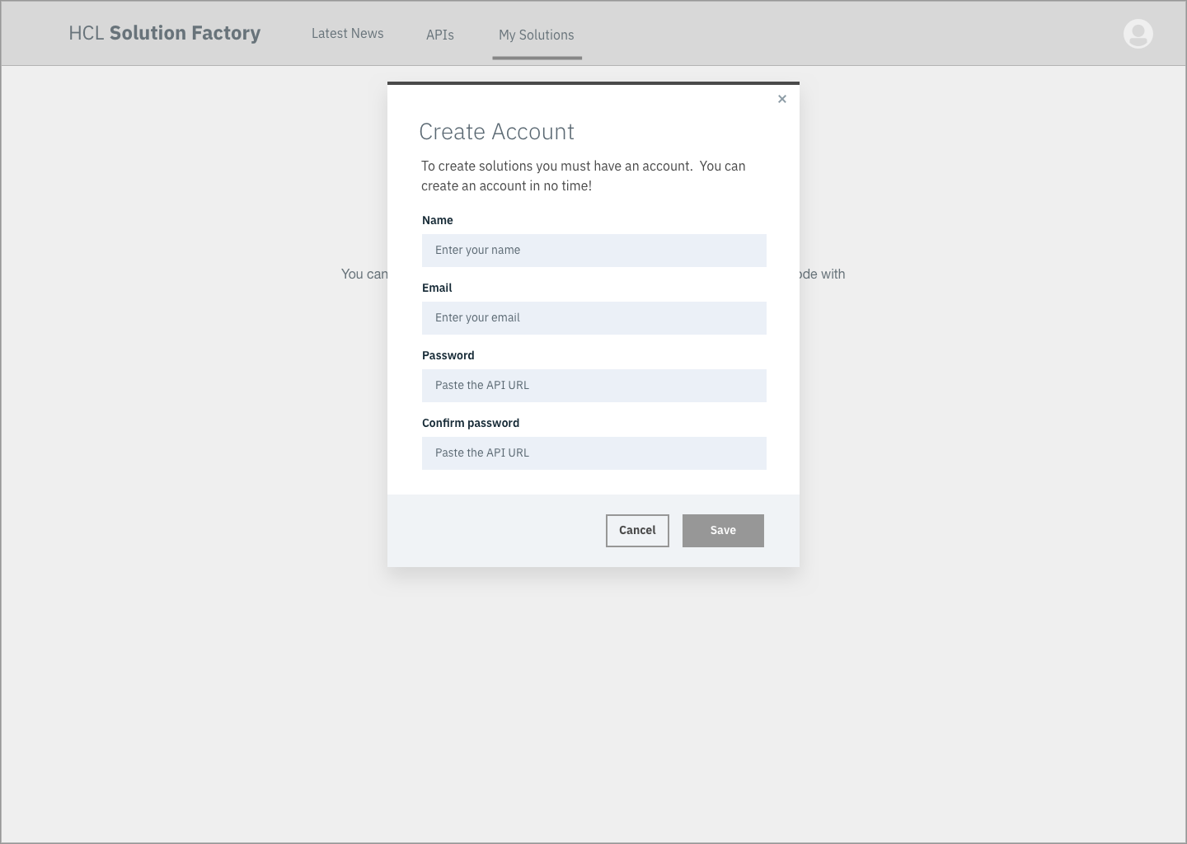
Chooses to create an account

Slide 4
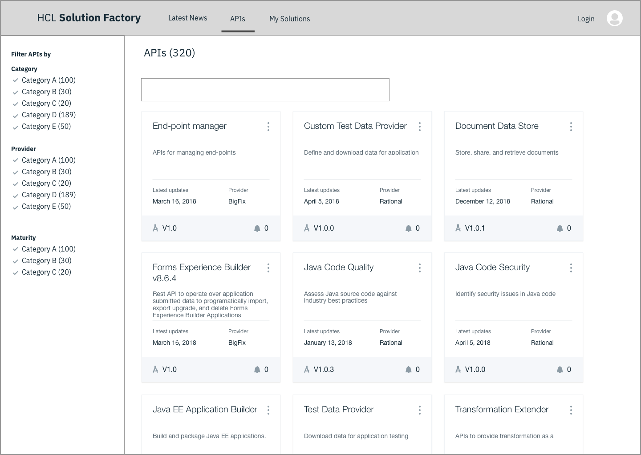
Solution Architect Sees APIs and My Solutions
Notes:
When looking at API page:
Sees a list of available APIs
Can search by string
Can browse by tag or keywords
Most commonly used APis

Slide 5
Solution Architect Views an API
Notes:
Sees the name of the API
Sees other properties of the API
Reference documentation
Who created the API, Who supports the API.
Can explore (Try out) the api
Sees the action to Add API
To a new solution
To an existent solution
Forum to ask other community member about APIs.

Slide 6
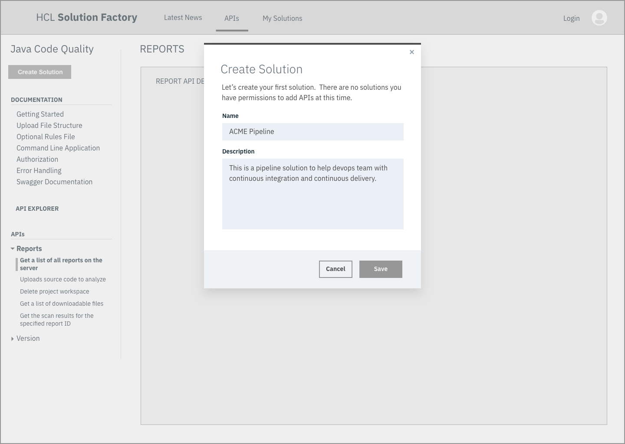
Solution Architect Chooses to create a new solution
Notes:
Provides name for solution
Provides description for solution
Has option to share solution with colleagues
….

Slide 7
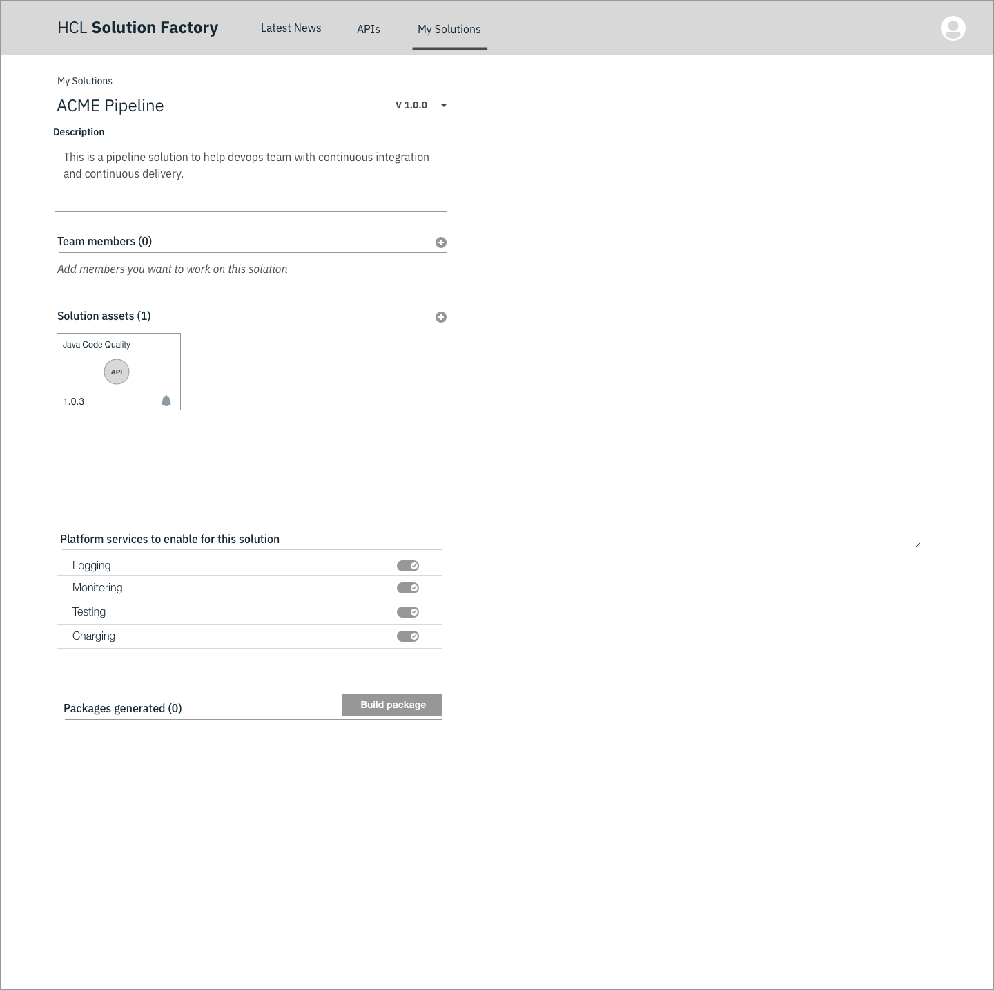
Solution Architect Sees the Solution Detail page
Notes:
Sees the name
Description
Members
Assets: lists the API he wanted to add the new solution.
He sees also the option to bring his application code
She can add external APIs.
She sees marking that let her know of APIs that have been updated.
Logging (on/off) My own
Monitoring (on/off)
Test (on/off)
Charging
When creating the package: Provide progress + detail
There might be other details to create the package.

Slide 8
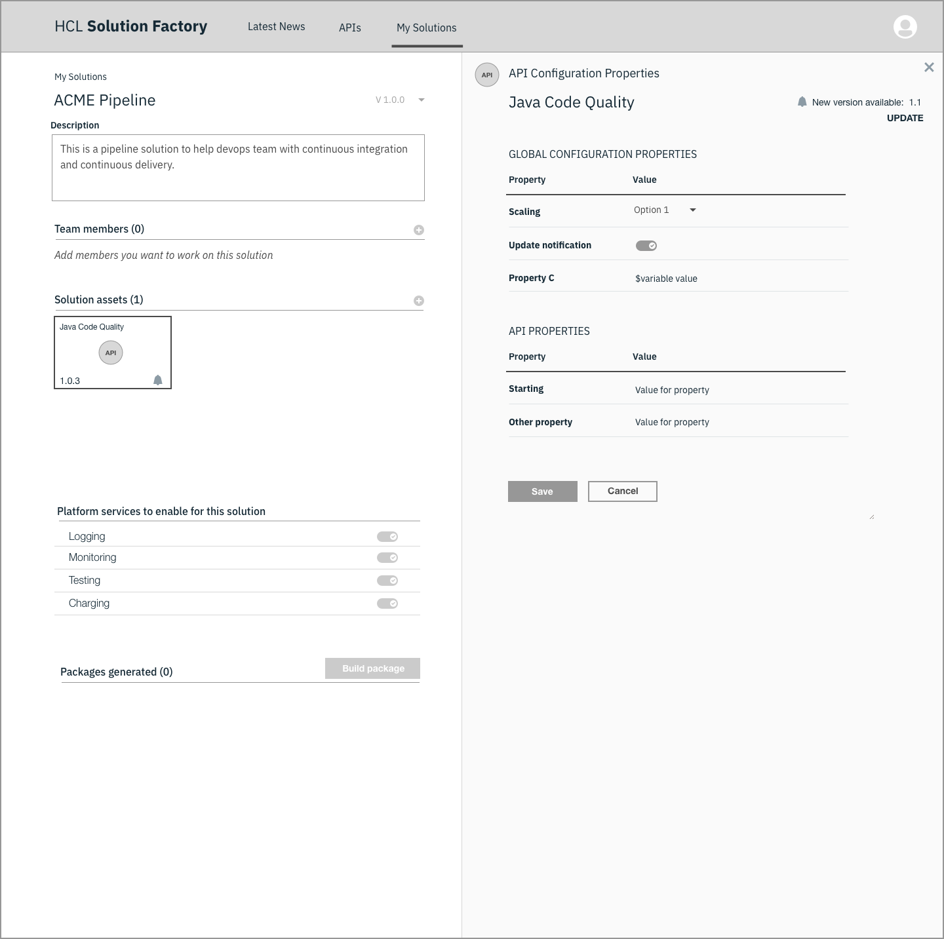
Solution Architect Sees the Solution Detail page
Notes:
Sees the name
Description
Members
Assets: lists the API he wanted to add the new solution.
He sees also the option to bring his application code
She can add external APIs.
She sees marking that let her know of APIs that have been updated.
Logging (on/off) My own
Monitoring (on/off)
Test (on/off)
Charging
When creating the package: Provide progress + detail
There might be other details to create the package.

Slide 9
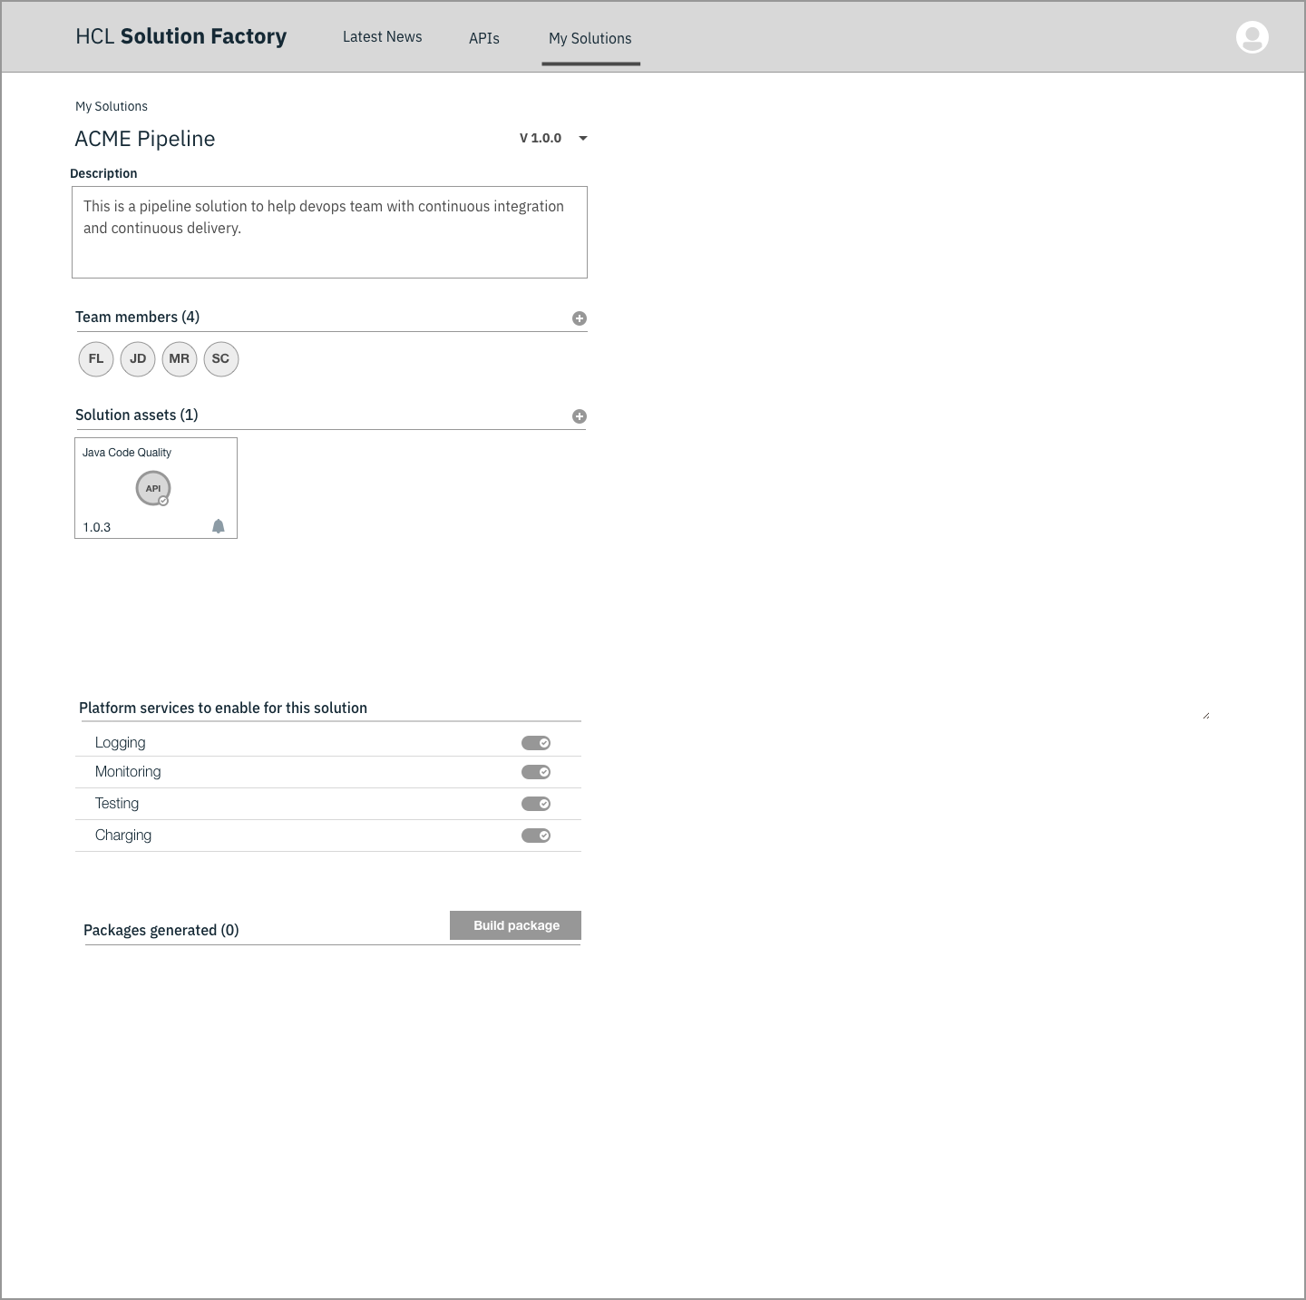
Solution Architect Sees the Solution Detail page
Notes:
Sees the name
Description
Members
Assets: lists the API he wanted to add the new solution.
He sees also the option to bring his application code
She can add external APIs.
She sees marking that let her know of APIs that have been updated.
Logging (on/off) My own
Monitoring (on/off)
Test (on/off)
Charging
When creating the package: Provide progress + detail
There might be other details to create the package.

Slide 10
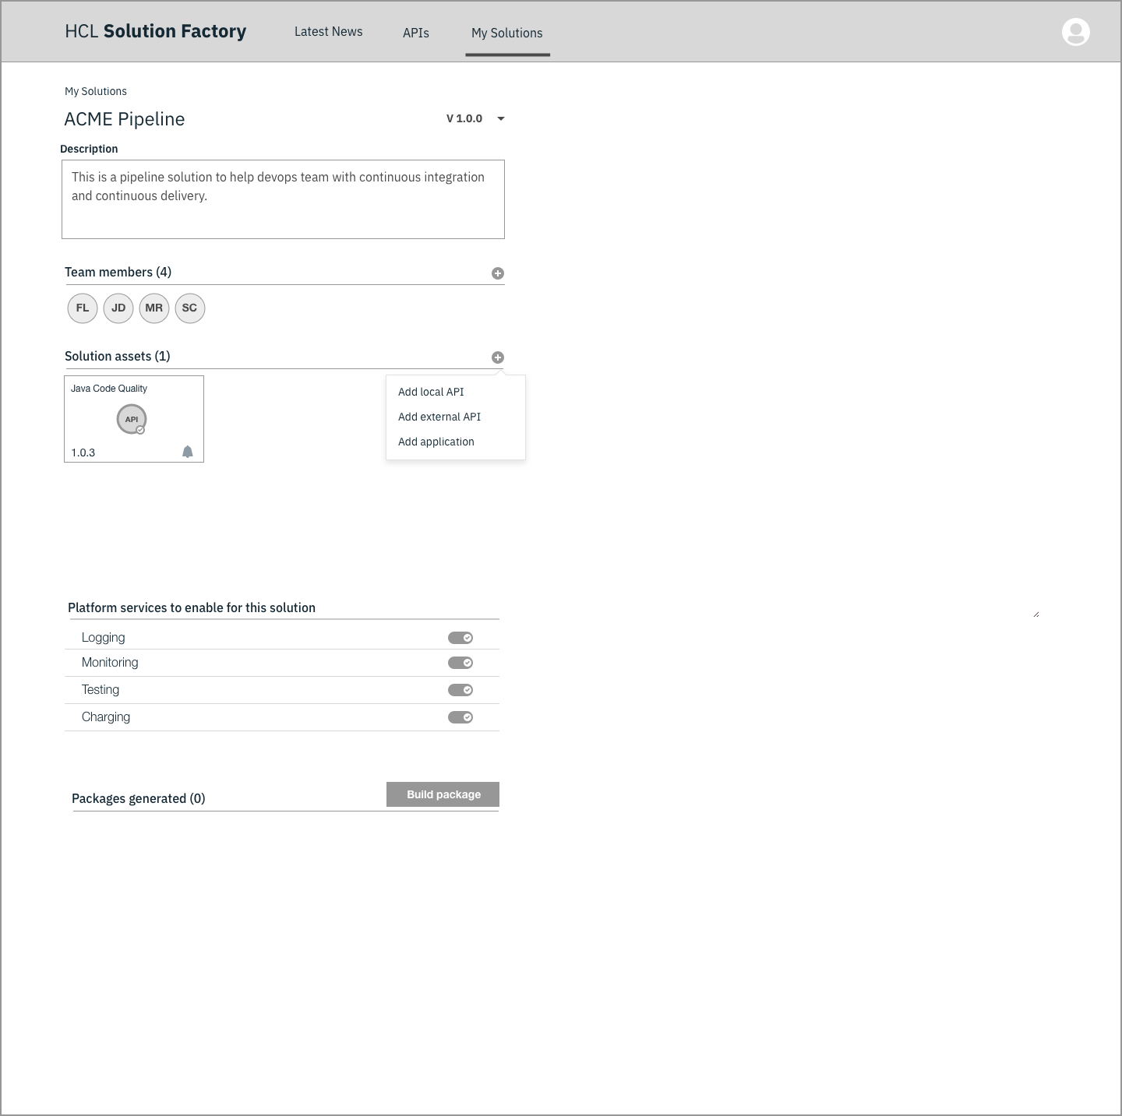
Solution Architect Sees the Solution Detail page
Notes:
Sees the name
Description
Members
Assets: lists the API he wanted to add the new solution.
He sees also the option to bring his application code
She can add external APIs.
She sees marking that let her know of APIs that have been updated.
Logging (on/off) My own
Monitoring (on/off)
Test (on/off)
Charging
When creating the package: Provide progress + detail
There might be other details to create the package.

Slide 11
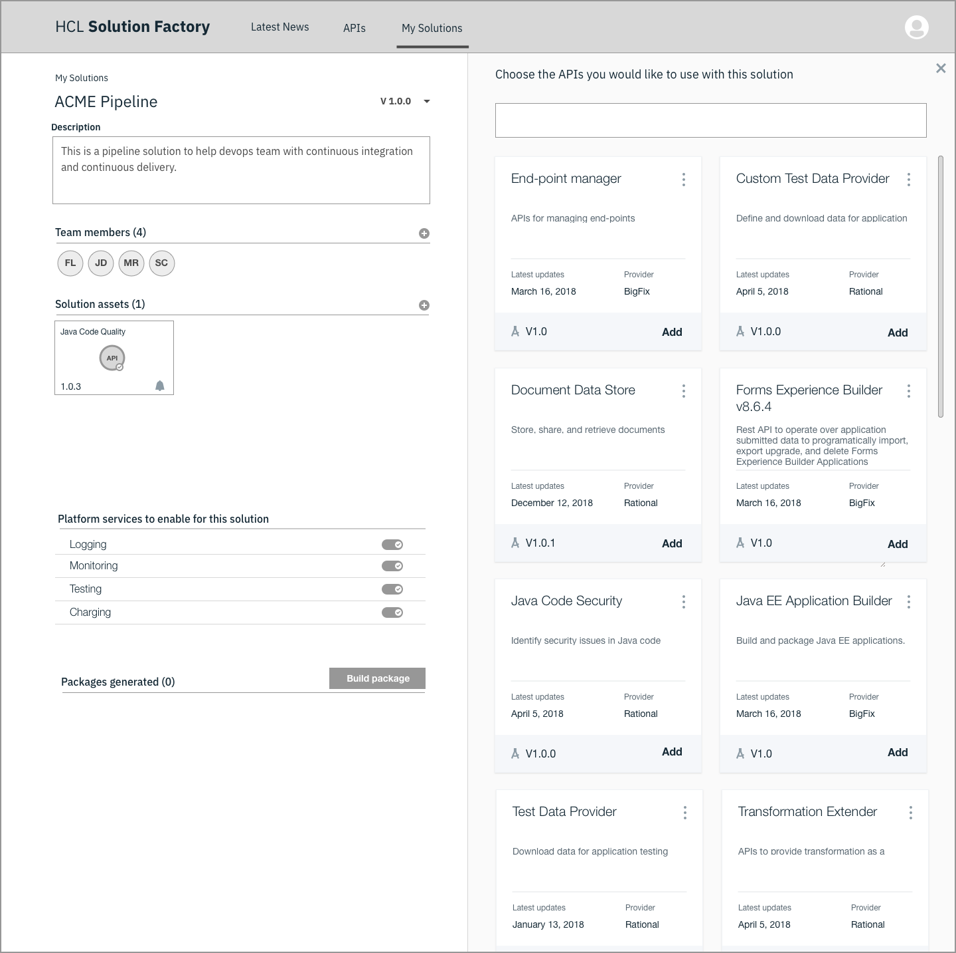
Solution Architect Sees the Solution Detail page
Notes:
Sees the name
Description
Members
Assets: lists the API he wanted to add the new solution.
He sees also the option to bring his application code
She can add external APIs.
She sees marking that let her know of APIs that have been updated.
Logging (on/off) My own
Monitoring (on/off)
Test (on/off)
Charging
When creating the package: Provide progress + detail
There might be other details to create the package.

Slide 12
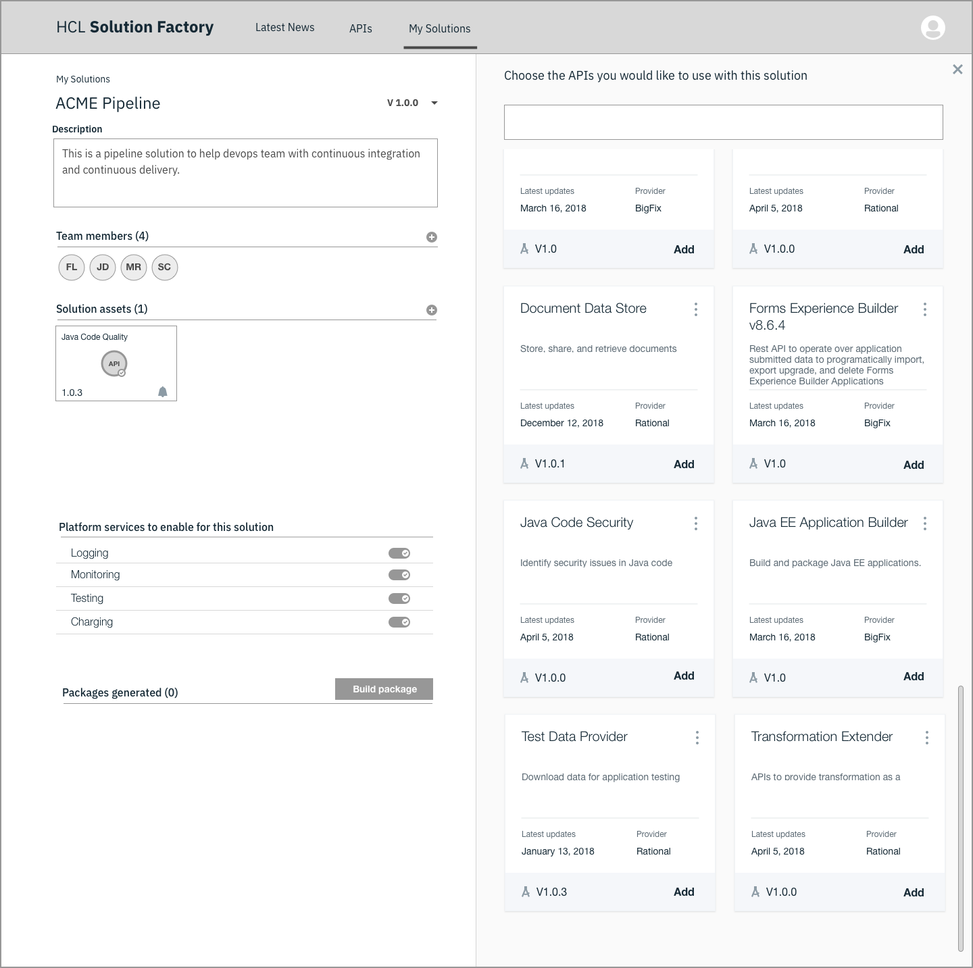
Solution Architect Sees the Solution Detail page
Notes:
Sees the name
Description
Members
Assets: lists the API he wanted to add the new solution.
He sees also the option to bring his application code
She can add external APIs.
She sees marking that let her know of APIs that have been updated.
Logging (on/off) My own
Monitoring (on/off)
Test (on/off)
Charging
When creating the package: Provide progress + detail
There might be other details to create the package.

Slide 13
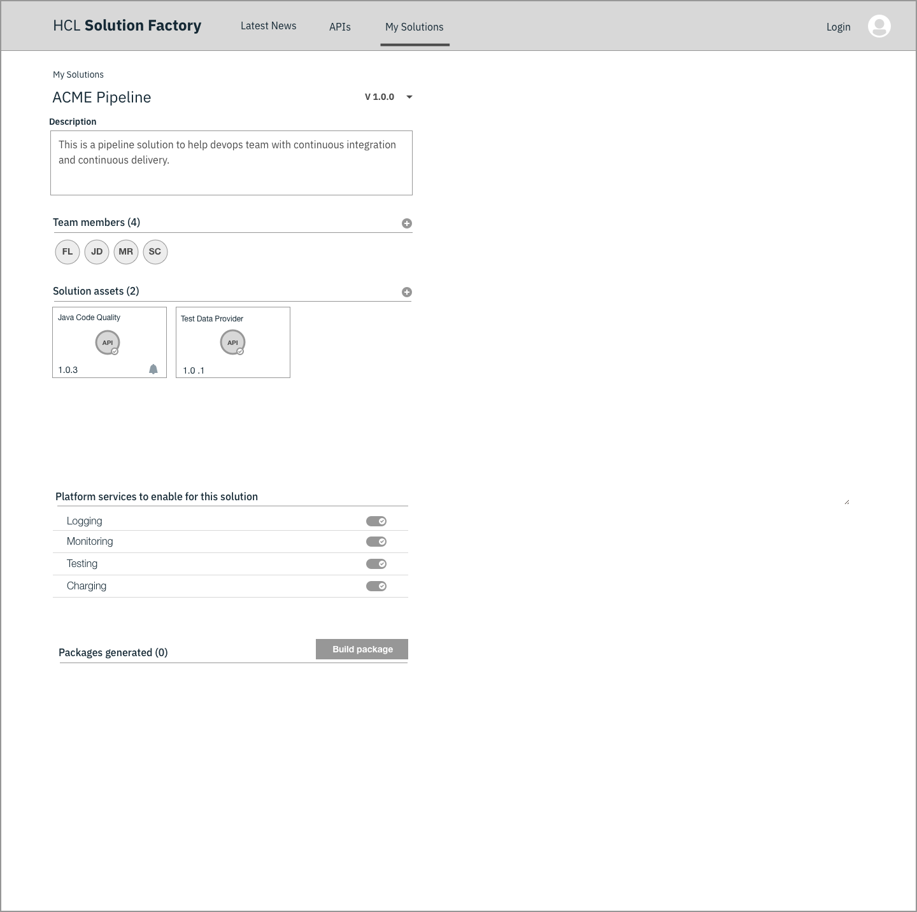
Solution Architect Sees the Solution Detail page
Notes:
Sees the name
Description
Members
Assets: lists the API he wanted to add the new solution.
He sees also the option to bring his application code
She can add external APIs.
She sees marking that let her know of APIs that have been updated.
Logging (on/off) My own
Monitoring (on/off)
Test (on/off)
Charging
When creating the package: Provide progress + detail
There might be other details to create the package.

Slide 14
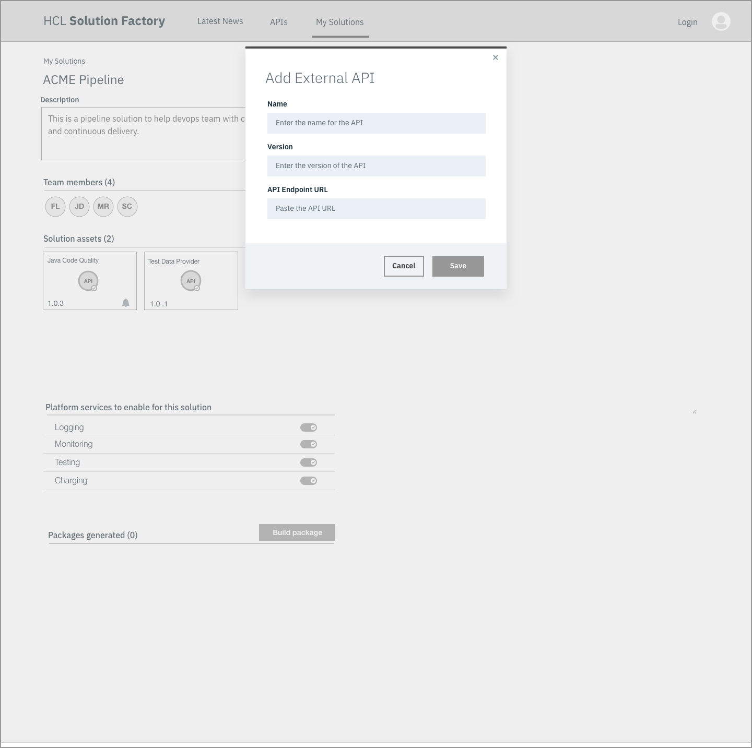
Solution Architect Sees the Solution Detail page
Notes:
Sees the name
Description
Members
Assets: lists the API he wanted to add the new solution.
He sees also the option to bring his application code
She can add external APIs.
She sees marking that let her know of APIs that have been updated.
Logging (on/off) My own
Monitoring (on/off)
Test (on/off)
Charging
When creating the package: Provide progress + detail
There might be other details to create the package.

Slide 15
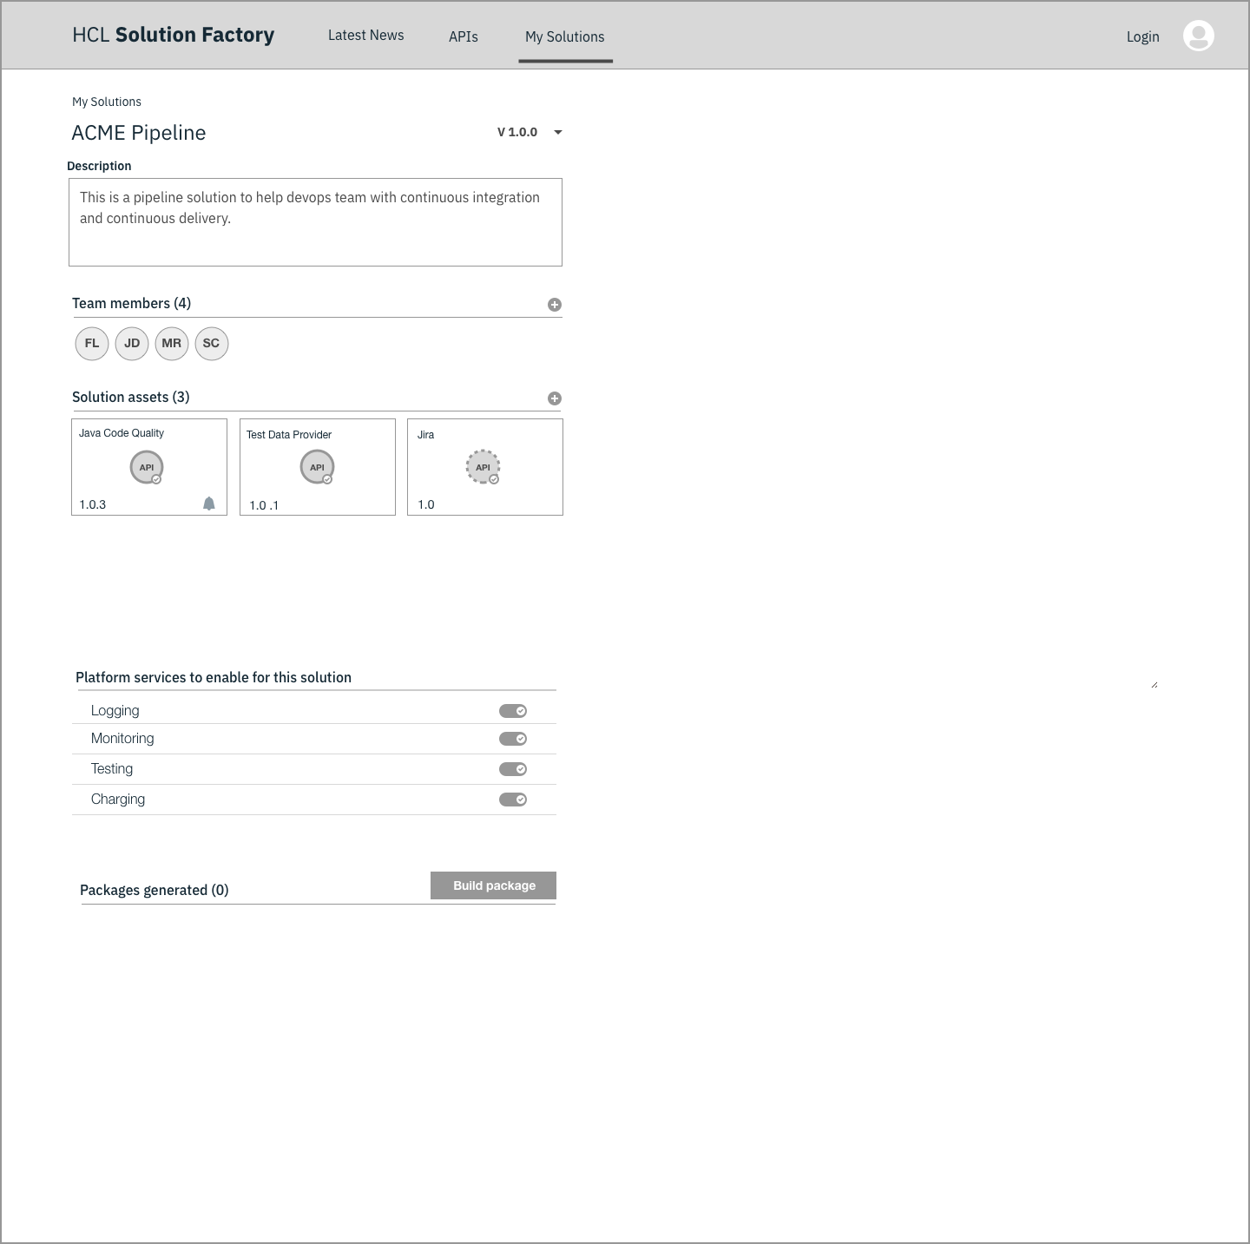
Solution Architect Sees the Solution Detail page
Notes:
Sees the name
Description
Members
Assets: lists the API he wanted to add the new solution.
He sees also the option to bring his application code
She can add external APIs.
She sees marking that let her know of APIs that have been updated.
Logging (on/off) My own
Monitoring (on/off)
Test (on/off)
Charging
When creating the package: Provide progress + detail
There might be other details to create the package.

Slide 16

Solution Architect Sees the Solution Detail page
Notes:
Sees the name
Description
Members
Assets: lists the API he wanted to add the new solution.
He sees also the option to bring his application code
She can add external APIs.
She sees marking that let her know of APIs that have been updated.
Logging (on/off) My own
Monitoring (on/off)
Test (on/off)
Charging
When creating the package: Provide progress + detail
There might be other details to create the package.

Slide 17
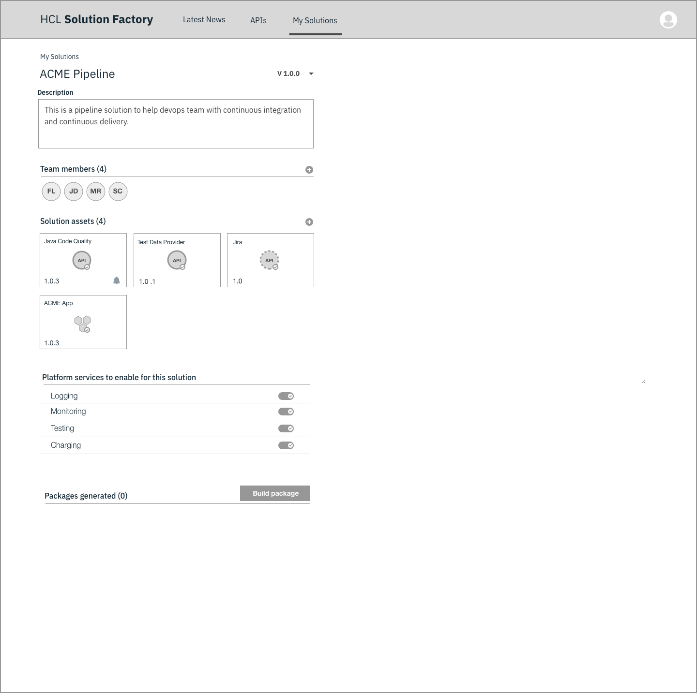
Solution Architect Sees the Solution Detail page
Notes:
Sees the name
Description
Members
Assets: lists the API he wanted to add the new solution.
He sees also the option to bring his application code
She can add external APIs.
She sees marking that let her know of APIs that have been updated.
Logging (on/off) My own
Monitoring (on/off)
Test (on/off)
Charging
When creating the package: Provide progress + detail
There might be other details to create the package.

Slide 18
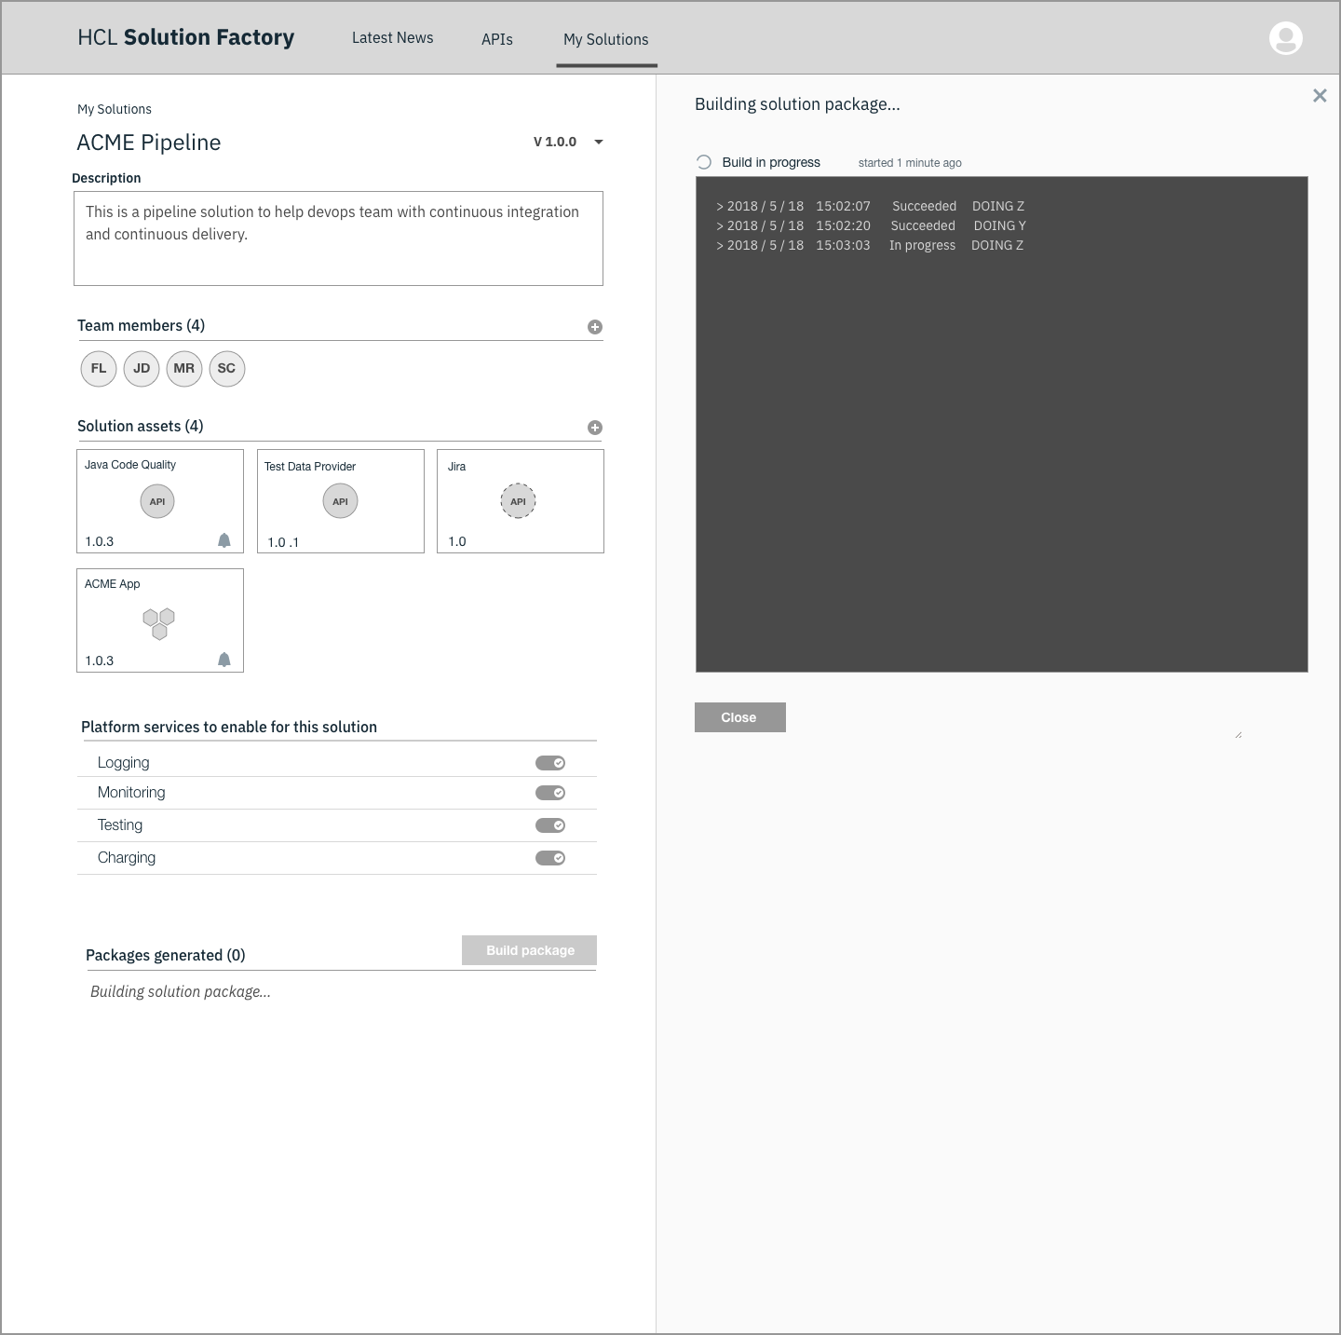
Solution Architect Sees the Solution Detail page
Notes:
Sees the name
Description
Members
Assets: lists the API he wanted to add the new solution.
He sees also the option to bring his application code
She can add external APIs.
She sees marking that let her know of APIs that have been updated.
Logging (on/off) My own
Monitoring (on/off)
Test (on/off)
Charging
When creating the package: Provide progress + detail
There might be other details to create the package.

Slide 19
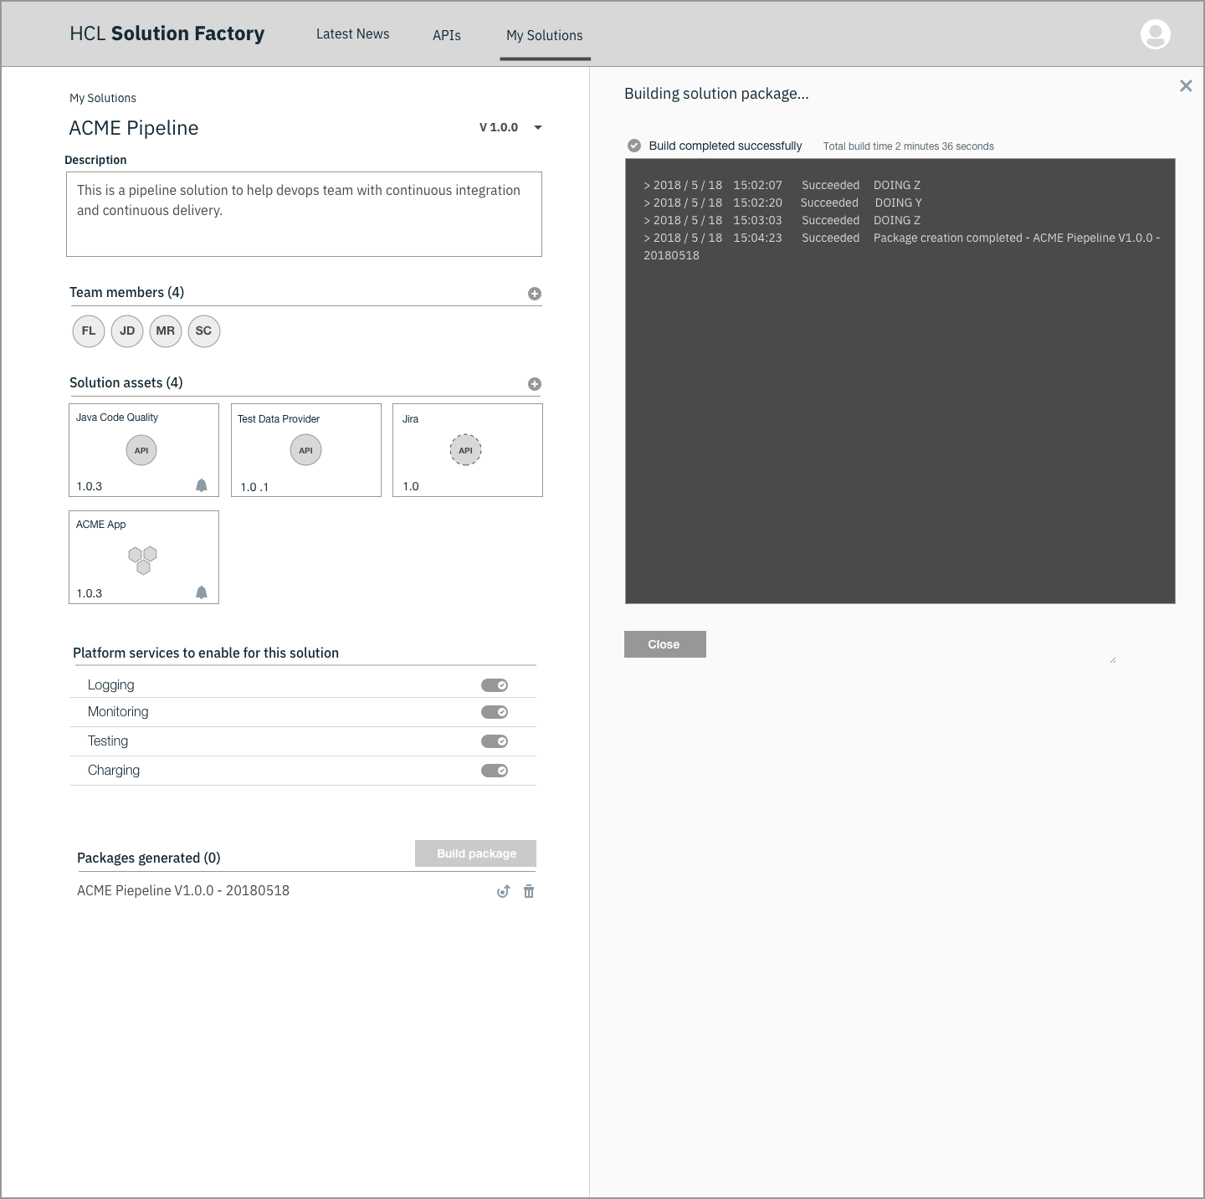
Solution Architect Sees the Solution Detail page
Notes:
Sees the name
Description
Members
Assets: lists the API he wanted to add the new solution.
He sees also the option to bring his application code
She can add external APIs.
She sees marking that let her know of APIs that have been updated.
Logging (on/off) My own
Monitoring (on/off)
Test (on/off)
Charging
When creating the package: Provide progress + detail
There might be other details to create the package.

Slide 20
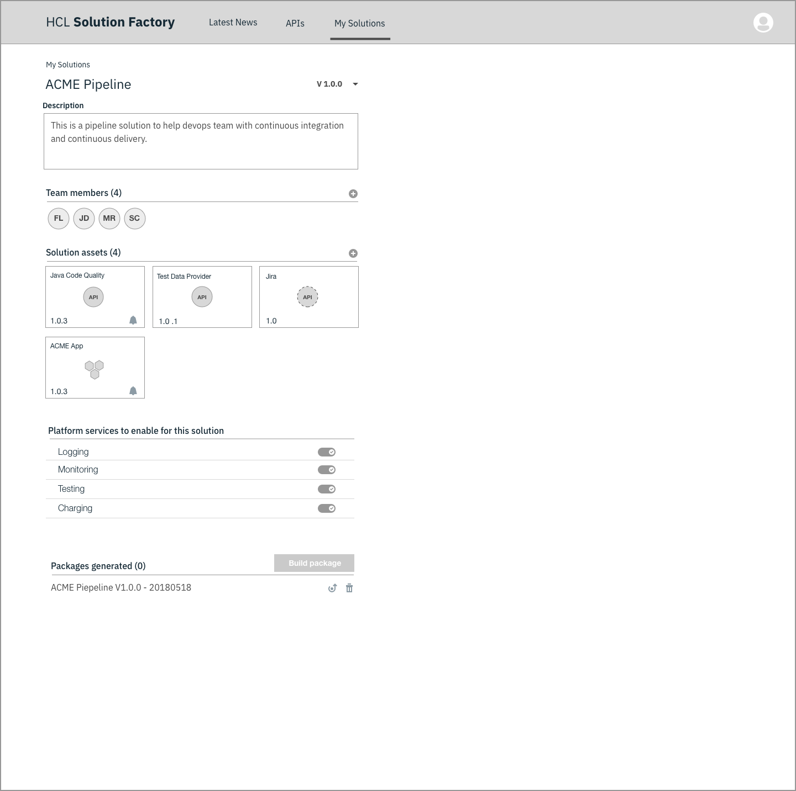
Solution Architect Sees the Solution Detail page
Notes:
Sees the name
Description
Members
Assets: lists the API he wanted to add the new solution.
He sees also the option to bring his application code
She can add external APIs.
She sees marking that let her know of APIs that have been updated.
Logging (on/off) My own
Monitoring (on/off)
Test (on/off)
Charging
When creating the package: Provide progress + detail
There might be other details to create the package.

Slide 21
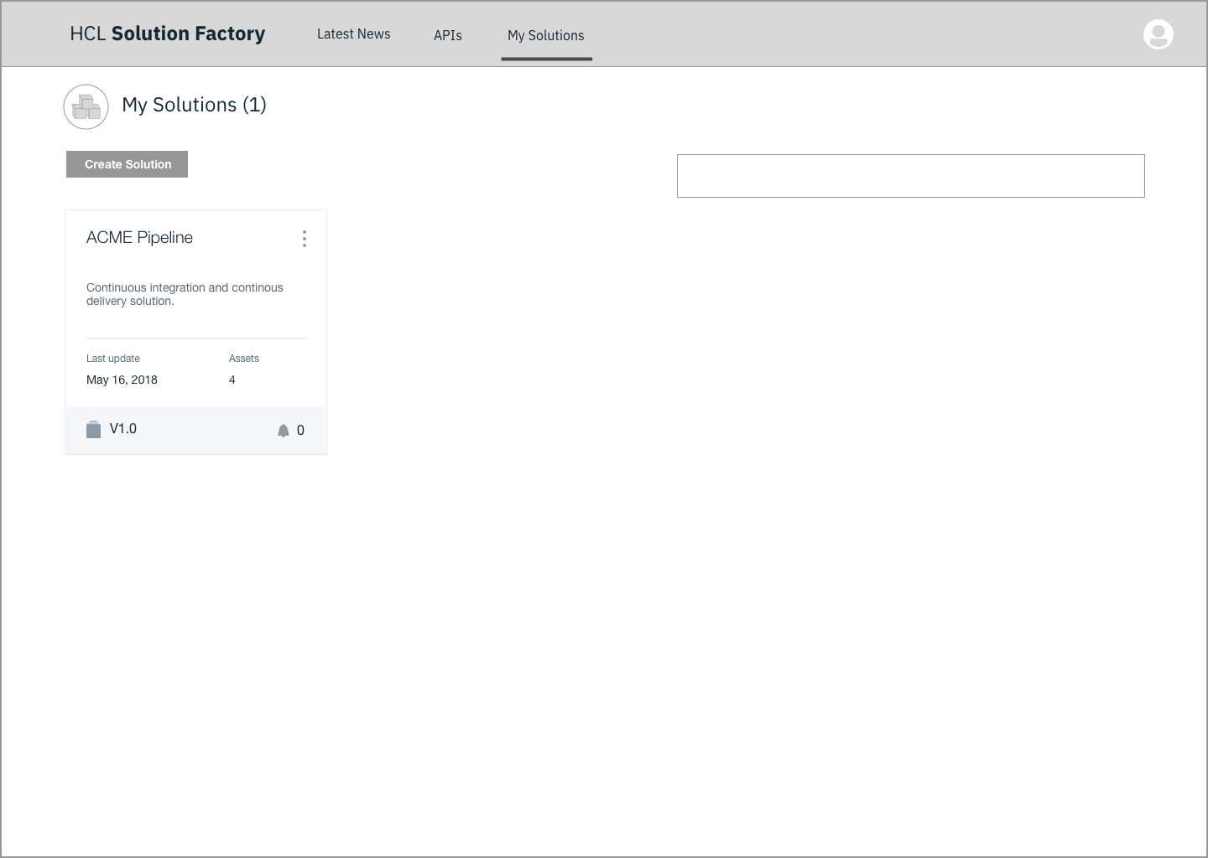
Solution Architect Sees the Solution Detail page
Notes:
Sees the name
Description
Members
Assets: lists the API he wanted to add the new solution.
He sees also the option to bring his application code
She can add external APIs.
She sees marking that let her know of APIs that have been updated.
Logging (on/off) My own
Monitoring (on/off)
Test (on/off)
Charging
When creating the package: Provide progress + detail
There might be other details to create the package.

